Slide 1


Slide 2


Rocxtar’z Website Layout
Factors of Production
  Land
  Labour
  Capital
  Organization
Designed by: Rocxtar
Designed by: Rocxtar
Designed by: Rocxtar

Slide 3

Rocxtar’z Website Layout
LAND
All the natural resources
Such as soil,minerals,oil,air
etc are considerd as Land.
It’s a natural Resource,it
is God gifted and it’s
Fixed.
Designed by: Rocxtar
Designed by: Rocxtar
Designed by: Rocxtar

Slide 4

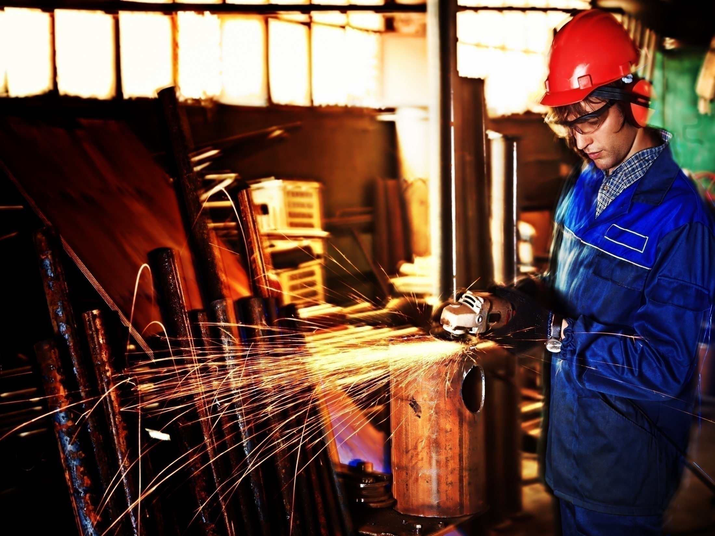
Rocxtar’z Website Layout
Labour
All the work force including
Technical,Human,Conceptual
Skill work on the land to
Produce goods and services
is called Labour.
Designed by: Rocxtar
Designed by: Rocxtar
Designed by: Rocxtar

Slide 5

Rocxtar’z Website Layout
Skills
  Human skills
  Conceptual skills
  Technical skills
Designed by: Rocxtar
Designed by: Rocxtar
Designed by: Rocxtar

Slide 6
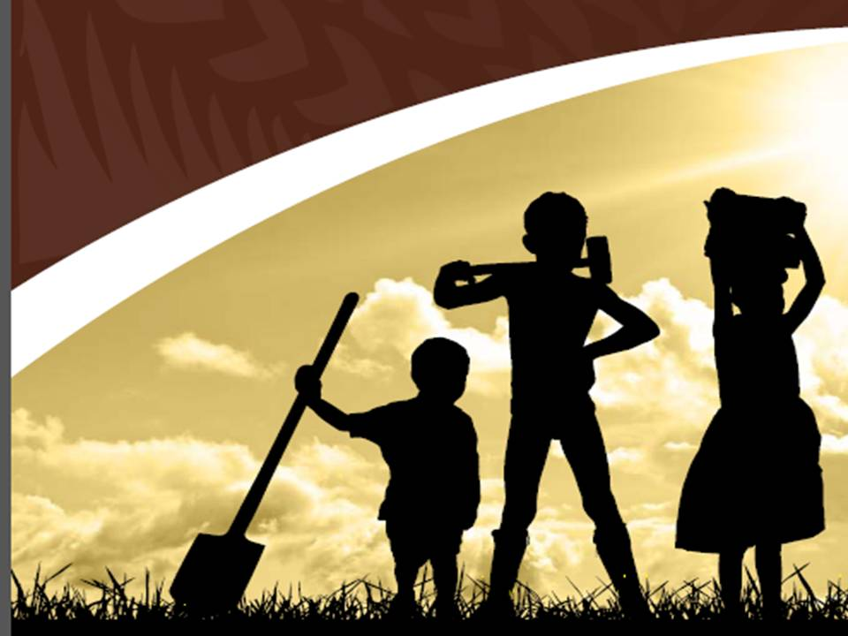
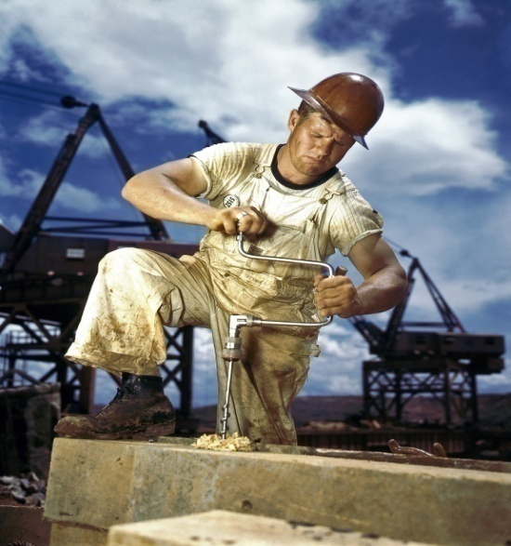
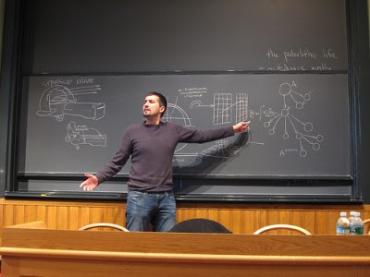
Rocxtar’z Website Layout
Types of Labour
  Physically Labour
  Mentally Labour
Designed by: Rocxtar
Designed by: Rocxtar
Designed by: Rocxtar

Slide 7

Rocxtar’z Website Layout
Capital
Amount invested by the owner of the
Bussines in his bussines is called Capital.
A pact from Land to labour all the money
Which is invested to purchase Machines,
Building,Equipments etc,Contributed by the
Owner is called Capital.
Designed by: Rocxtar
Designed by: Rocxtar
Designed by: Rocxtar

Slide 8

Rocxtar’z Website Layout
Organization
Two or more than two People work
Together for the achievment of a Common
Object is called Organization.
Designed by: Rocxtar
Designed by: Rocxtar
Designed by: Rocxtar

Slide 9
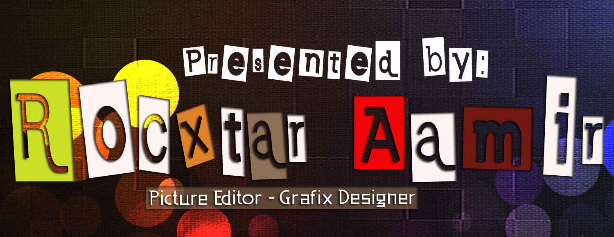

Slide 10
Rocxtar’z Website Layout
ThAnk’yEw ;)
Designed by: Rocxtar
Designed by: Rocxtar

